Slide 1



6. Classes & Objects
Let’s Learn
Aj. Andrew Davison, CoE, PSU Hat Yai Campus
E-mail: ad@fivedots.coe.psu.ac.th
a class
factory
makes objects
+
functions
library

Slide 2
Outline
What is an Object?
What is a Class?
Car Class
Person Class
Inheritance
Inheritance in Python
OOP

Slide 3


1. What is an Object?
An object groups together all the data related to one thing.
e.g. each Person object might contain name and birthday data for a person
Person object
Person object
Person object
name
"Alice"
name
"John"
name
"Bill"
p1
p2
p3
birth
day
5/6/2001
birth
day
3/2/2002
birth
day
2/2/2002
the p1, p2, p3 Person objects

Slide 4
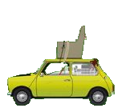


2. What is a Class?
A class is two things:
a factory for making objects
a library of functions that objects can use
A Car class:
factory
+
functions
library
makes Car objects

Slide 5
Possible Car Objects
Car object
Car object
Car object
dist
2
dist
5
dist
100000
car1
car1
car1
type
"ferrarri"
type
"porsche"
"bean"
type
color
"red"
color
"green"
"yellow"
color
could be lots of other things
in a real Car object

Slide 6
3.Car Class (car.py)
class Car:
def __init__(self, dist, type, color):
# factory method (constructor)
self.dist = dist
self.type = type
self.color = color
def __str__(self):
# returns a string version of the object
return "(" + str(self.dist) + ", " +
self.type + ", " + self.color + ")"
def drive(self, miles):
if miles < 0:
print("Drive distance cannot be negative")
else:
self.dist += miles
def setType(self, type):
if type in ["ferrari", "porsche", "bean", "toyota"]:
self.type = type
else:
print(type, "not supported")
def setColor(self, color):
self.color = color
def getColor(self):
return self.color
will create
an object
with 3 pieces
of data
class contains
6 functions
(including the
constructor)

Slide 7
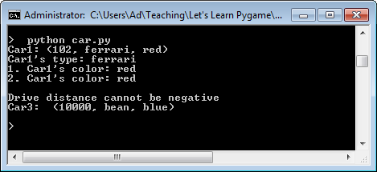
Test Code
# create 3 Car objects
car1 = Car(2, "ferrari", "red") # uses __init__()
car2 = Car(5, "porsche", "green")
car3 = Car(10000, "bean", "yellow")
car1.drive(100)
print("Car1:", car1) # uses __str__()
print("Car1's type:", car1.type)
print("1. Car1's color:", car1.getColor())
print("2. Car1's color:", car1.color)
print()
car3.setColor("blue")
car3.drive(-9999)
print("Car3: ", car3)

Slide 8
What is self?
self is the first argument of every function definition
tells the function which object's data to use
self is not included when a function is called
Instead Python puts the name before the ".":
car1.getColor() means call getColor() with car1's data

Slide 9
Two Ways to Access (get) Data
Directly: car1.color
With a function: car1.getColor()
Using a function means that the data can be changed before being returned.
e.g.
def getColor():
return self.color.upper()

Slide 10
Two ways to Change (set) Data
Directly: car1.dist = -1
With a function: car1.drive(9999)
Using a function means that the data can be protected from "bad" changes.
e.g.
def drive(self, miles):
if miles < 0:
print("Drive distance cannot be negative")
else:
self.dist += miles
Using a function is better programming style.

Slide 11
4. Person Class
import datetime
class Person():
def __init__(self, name):
self.name = name
self.birthday = None
def __str__(self):
return self.name + ": " + str(self.birthday)
def getName(self):
return self.name
def setBirthday(self, day, month, year):
self.birthday = datetime.date(year, month, day)
def getAge(self):
# returns self's current age in days
if self.birthday == None:
print("No birthday information")
return 0
else:
return (datetime.date.today() – self.birthday).days
will create
an object
with 2 pieces
of data
class contains
5 functions
(including the
constructor)

Slide 12
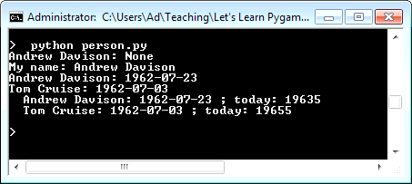
Test Code
# create two Person objects
me = Person("Andrew Davison")
print(me)
print("My name:", me.getName())
me.setBirthday(23, 7, 1962)
print(me)
tom = Person("Tom Cruise")
tom.setBirthday(3, 7, 1962)
print(tom)
people = [me, tom]
for p in people:
print(" ", p, "; today:", p.getAge())

Slide 13
5. Inheritance
"a" inherits from "b" when "a" is like "b" but with extra features (and maybe a few changes).
"a" is a specialized version of "b"
animal
inherits
mammal
insect
bear
cat
dog
ant
cockroach
mosquito

Slide 14
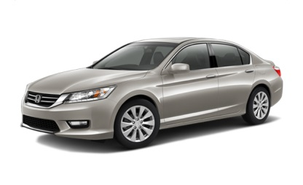




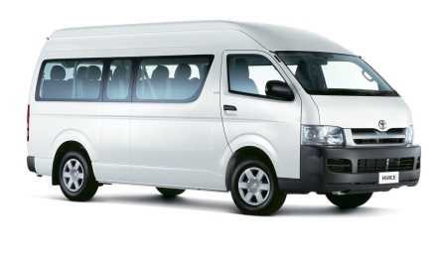
vehicle
inherits
car
bus
truck
sedan
van
SUV
pickup
semi
tow

Slide 15
6. Inheritance in Python
Create a new class by inheriting an existing class
no need to start programming from nothing
e.g. Student class inherits Person class
The Student class can add extra data and functions to the ones inherited from Person.

Slide 16
Student Inherits Person
class Student(Person):
def __init__(self, name, id):
super().__init__(name) # initialize Person data
self.id = id
def __str__(self):
return super().__str__() + " (" + str(self.id )+ ")"
# return all data
def setId(self, id):
self.id = id
will create
an object
with 3 pieces
of data
class contains
8 functions
(including the
2 constructors)
super() means
use the function from
the inherited class

Slide 17
How much data & functions?
A Person object has 3 pieces of data:
name and birthday inherited from Student
id from Person
The Person class contains 8 functions:
5 functions inherited from Student
3 functions from Person
there are two __init() and __str__() functions
use super() to call the inherited ones

Slide 18
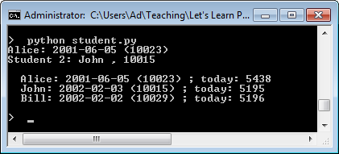
Test Code
# test code
s1 = Student('Alice', 10023)
s1.setBirthday(5, 6, 2001)
s2 = Student('John', 10015)
s2.setBirthday(3, 2, 2002)
s3 = Student('Bill', 10029)
s3.setBirthday(2, 2, 2002)
print(s1)
print("Student 2:", s2.name, ",", s2.id)
print()
students = [s1,s2,s3]
for s in students:
print(" ", s, "; today:", s.getAge())
Student object
name
"Alice"
s1
birth
day
5/6/2001
id
10023
can use name directly
can call getAge()

Slide 19
7. OOP
OOP stands for Object Oriented Programming
It means that the programming language has the features:
classes and objects
inheritance
polymorphism
this can mean a few different things. e.g.
a data structure (e.g. a list) can contain different kinds of objects
the same function can work on different kinds of objects
Python is an OOP language
Other OOP languages are Java and C++

